Slide 1

CZ3005 Artificial Intelligence Markov Decision Process
Asst/P Hanwang Zhang
https://personal.ntu.edu.sg/hanwangzhang/
Email: hanwangzhang@ntu.edu.sg
Office: N4-02c-87

Slide 2
Lesson Outline
Introduction
Markov Decision Process
Two methods for solving MDP
Value iteration
Policy iteration

Slide 3
Introduction
We consider a framework for decision making under uncertainty
Markov decision processes (MDPs) and their extensions provide an extremely general way to think about how we can act optimally under uncertainty
For many medium-sized problems, we can use the techniques from this lecture to compute an optimal decision policy
For large-scale problems, approximate techniques are often needed (more on these in later lectures), but the paradigm often forms the basis for these approximate methods
Notes:
MDP is our first time to deal with non-deterministic search strategy.

Slide 4
Game Show
A series of questions with increasing level of difficulty and increasing payoff
Decision: at each step, take your earnings and quit, or go for the next question
If you answer wrong, you lose everything
$100 question
$1,000 question
$10,000 question
$50,000 question
Correct:
$61,100
Q1
Correct
Q2
Correct
Q3
Correct
Q4
Incorrect:
$0
Incorrect:
$0
Incorrect:
$0
Incorrect:
$0
Quit:
$100
Quit:
$1,100
Quit:
$11,100
Notes:
We only care about the reward. Our goal is to max the expected reward. In non-deterministic env, we only care about the expectation. This is the key rationale between machine and humans, as we usually are not well-rounded as machine.
For the first Q1, no issue. You own nothing at the beginning, why not trying?
But for Q2, problematic. What is the reward for correct EXACTLY? If I quit, I got 100. besides, is Q2 reward only 1000? Not exactly, as Q2 is just a premise for Q3, and Q3 is a premise for Q4, so on so forth. Far reaching reward in future.
In fact, we have already learned a strategy for calculating something goal yet unknown. Cue: dependency.

Slide 5
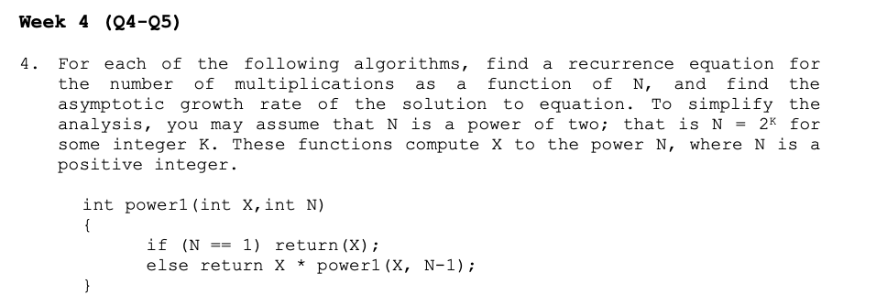
Recursive Mechanism

Slide 6
Game Show
Consider $50,000 question
Probability of guessing correctly: 1/10
Quit or go for the question?
What is the expected payoff for continuing?
0.1 * 61,100 + 0.9 * 0 = 6,110
What is the optimal decision?
$100 question
$1,000 question
$10,000 question
$50,000 question
Correct:
$61,100
Q1
Correct
Q2
Correct
Q3
Correct
Q4
Incorrect:
$0
Incorrect:
$0
Incorrect:
$0
Incorrect:
$0
Quit:
$100
Quit:
$1,100
Quit:
$11,100
Notes:
Where is P? A = no quit: P(s’ = correct|s = Q4’ correct, no quit) * 61100+P(s’ = incorrect|s = Q4’s correct, no quit) * 0 = 6,110.
A = quit: P(s’ = correct|s = Q4’correct, quit) = 0 * 0 + P(s’incorrect| s = Q4’correct, quit) = 1 * 11100 = 11100.
But, the truth is: you don’t know the transition probability, you don’t know 1/10.

Slide 7
Game Show
What should we do in Q3?
Payoff for quitting: $1,100
Payoff for continuing: 0.5 * $11,100 = $5,550
What about Q2?
$100 for quitting vs. $4,162 for continuing
What about Q1?
U = $3,746
U = $4,162
U = $5,550
U = $11,100
$100 question
$1,000 question
$10,000 question
$50,000 question
1/10
9/10
3/4
1/2
Correct:
$61,100
Q1
Correct
Q2
Correct
Q3
Correct
Q4
Incorrect:
$0
Incorrect:
$0
Incorrect:
$0
Incorrect:
$0
Quit:
$100
Quit:
$1,100
Quit:
$11,100
Notes:
Please do remember: we use P to average the reward! And tweak our action to maximize the average reward.

Slide 8
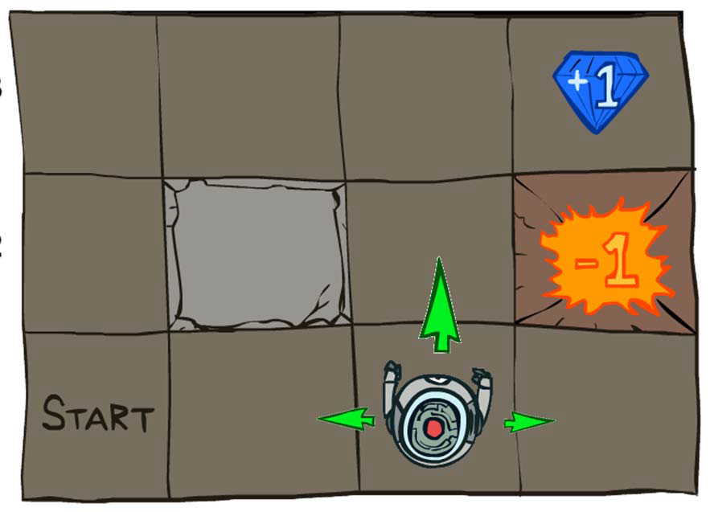
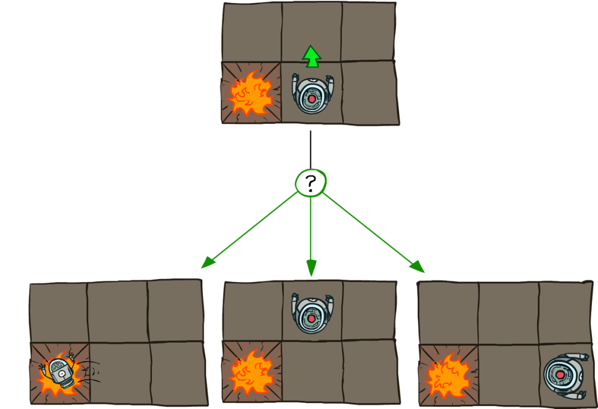
Grid World
Transition model:
0.1
0.8
0.1
R(s) = -0.04 for every non-terminal state
Source: P. Abbeel and D. Klein
Notes:
For some reasons, the transition is not fully deterministic, it is subject to the dynamic of the world.

Slide 9

Goal: Policy
Source: P. Abbeel and D. Klein
Notes:
Treasure map

Slide 10
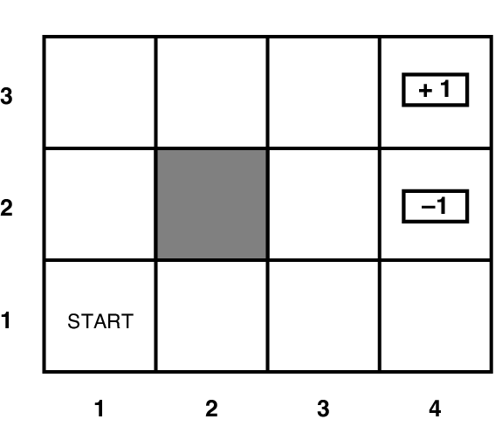
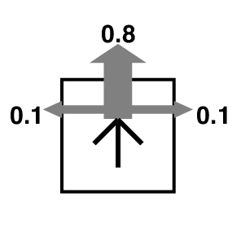
Grid World
Transition model:
R(s) = -0.04 for every non-terminal state

Slide 11
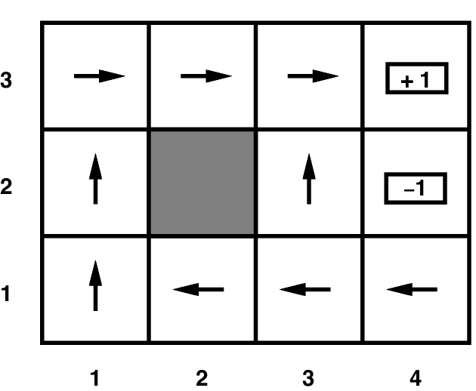
Grid World
Optimal policy when R(s) = -0.04 for every non-terminal state
Notes:
1. recursive. Always start from the very definitive reward. 2. a value for each state by expectation.. 3. always choose the action that max

Slide 12
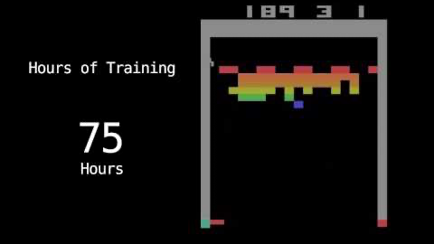

Atari Video Games
Execute actions to get the maximum
accumulated rewards

Slide 13
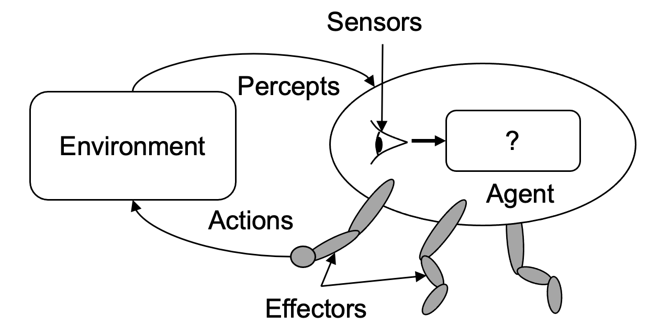
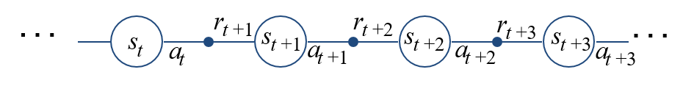
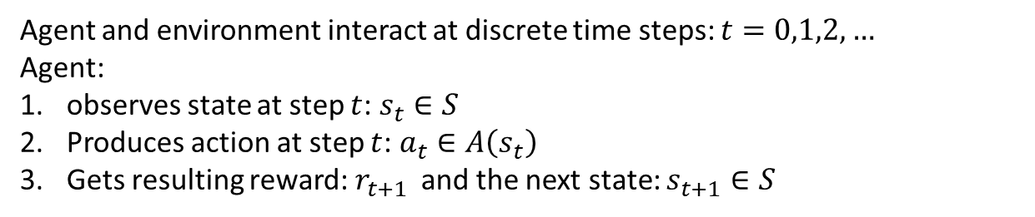
The Agent-Environment Interface
Agent and environment interact at discrete time steps: $t=0,1,2,…$
Agent:
observes state at step $t$: $s_{t}∈S$
Produces action at step $t$: $a_{t}∈A\left(s_{t}\right)$
Gets resulting reward: $r_{t+1 }$ and the next state: $s_{t+1}∈S$
Notes:
The percepts are represented by two features: state feature and reward

Slide 14
Making Complex Decisions
Make a sequence of decisions
Agent’s utility depends on a sequence of decisions
Sequential Decision Making
Markovian Property
Transition properties depend only on the current state, not on previous history (how that state was reached)
Markov Decision Processes
Notes:
Note: Markov is just an assumption. Any evidence that the assumption is reasonable? When current state and reward can characterize the history completely. For example, when you are in a job interview, the interviewer consider your degree of NTU and your transcripts as a state feature, they won’t care whether you attend this specific lecture.
Non-markovian: our course evaluation☺
Why we need this? Just give you a hint: you may consider this hint, and bring this into the following slides. Tn = Tn-1 + C.

Slide 15
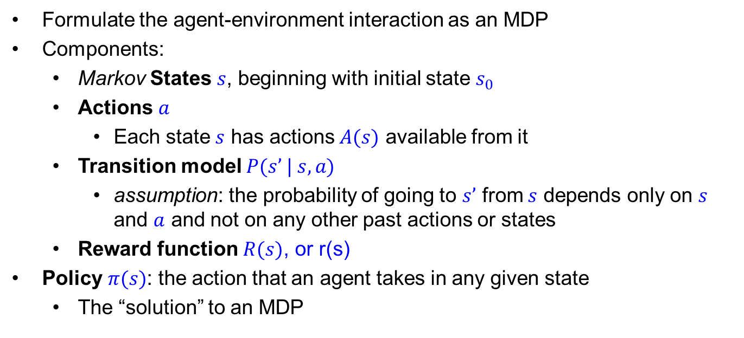
Markov Decision Processes
Formulate the agent-environment interaction as an MDP
Components:
Markov States $s$, beginning with initial state $s_{0}$
Actions $a$
Each state $s$ has actions $A(s)$ available from it
Transition model $P(s’ | s, a)$
assumption: the probability of going to $s’$ from $s$ depends only on $s$ and $a$ and not on any other past actions or states
Reward function $R(s)$, or r(s)
Policy $π(s)$: the action that an agent takes in any given state
The “solution” to an MDP
Notes:
Transition model is the physical model of the environment. Later, we will show that this is the link between action, past, and now(this is the only notation that has the time link☺). And this is also a strong assumption. In RL, we will relax this assumption, i.e., no model.
In this lecture, only from this, we can have a smart ``guess’’ about the “question mark” of the agent. Sometimes, it is quite horrible: after viewing your behaviors for some time, your parents can read your mind.
But don’t worry So many limitations.: Question: what is the challenge to read one’s mind? How to know the State representation? How to know the reward?
Rap-star, PI

Slide 16

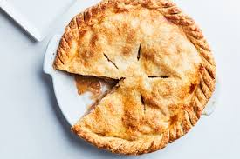
RAP-Star: PI
Notes:
P stands for punchline.

Slide 17
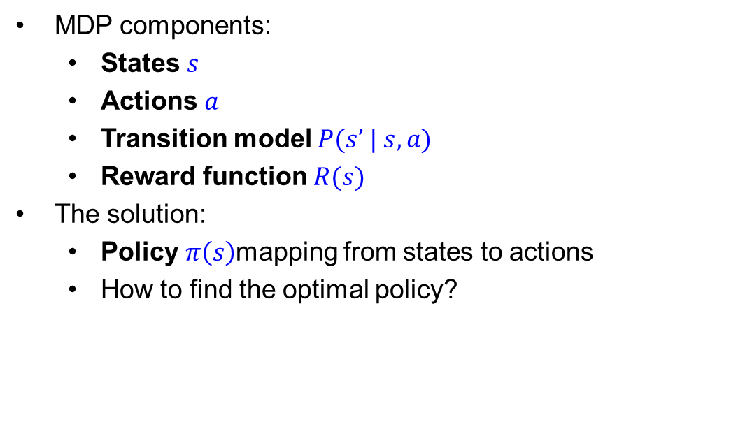
Solving MDPs
MDP components:
States $s$
Actions $a$
Transition model $P(s’ | s, a)$
Reward function $R(s)$
The solution:
Policy $π\left(s\right)$mapping from states to actions
How to find the optimal policy?
Notes:
In order to solve for a = pi(s), we need to establish equations. That is, to form a closed loop. To link/put them all together.
Again, special thanks to the transition model, which does a lot of favor.
Obviously, it is about to be closed. Except for how to use some function about pi to connect between s’ and s. That is
F(pi(s’)) = F(pi(s)) + something.

Slide 18
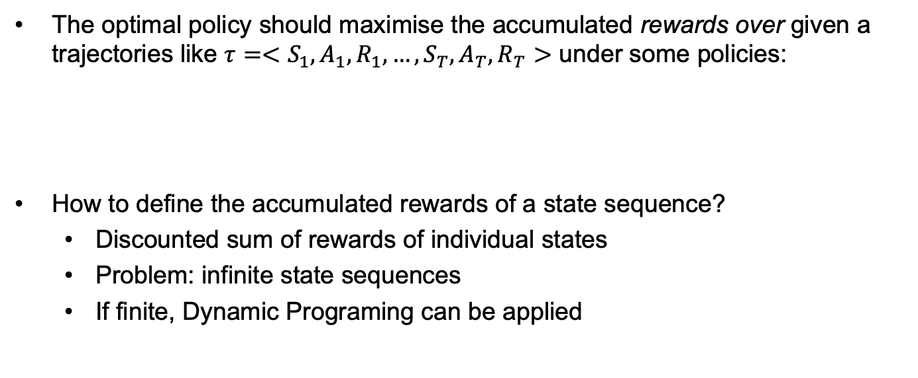
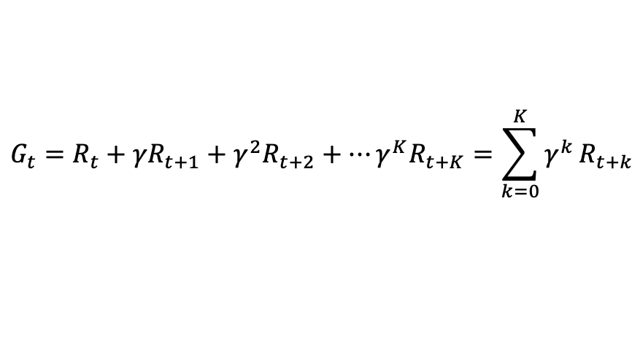
Maximizing Accumulated Rewards
The optimal policy should maximise the accumulated rewards over given a trajectories like $τ={<S}_{1}, A_{1},R_{1},…, S_{T}, A_{T}, R_{T}>$ under some policies:
How to define the accumulated rewards of a state sequence?
Discounted sum of rewards of individual states
Problem: infinite state sequences
If finite, Dynamic Programing can be applied
$$G_{t}=R_{t}+{γR}_{t+1}+γ^{2}R_{t+2}+…γ^{K}R_{t+K}=\sum_{k=0}^{K}{γ^{k}}R_{t+k}$$
Notes:
Don’t worry about how you get the subsequent R_t. Its just a promise when your job interview. Its not from simulation. This is just a generalized definition. No big deal.
It is essentially a hindsight.
Please have a closer look at this function. It is recursive in essence.
LP: given c, here, the reward vector R, find c^T x, that argmax–x c^Tx, subject to Ax <= b, x > 0

Slide 19
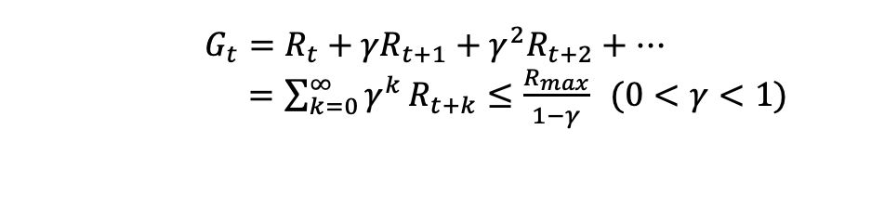
Accumulated Rewards
Normally, we would define the accumulated rewards of trajectories as the discounted sum of the rewards
Problem: infinite time horizon
Solution: discount the individual rewards by a factor γ between 0 and 1:
Sooner rewards count more than later rewards
Makes sure the total accumulated rewards stays bounded
Helps algorithms converge
$$G_{t}=R_{t}+{γR}_{t+1}+γ^{2}R_{t+2}+…$$
$=\sum_{k=0}^{∞}{γ^{k}}R_{t+k}≤\frac{R_{max}}{1−γ} (0<γ<1)$
Notes:
This is a common sense intuition: the money today is more valuable than money in future.
Think of an exception? AlphaGo or any process that does not care about the intermediate rewards. But this is also general: r = 1, Rt = 0.

Slide 20
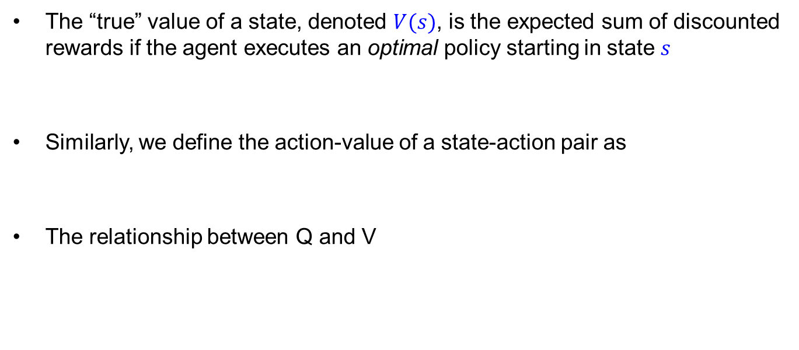
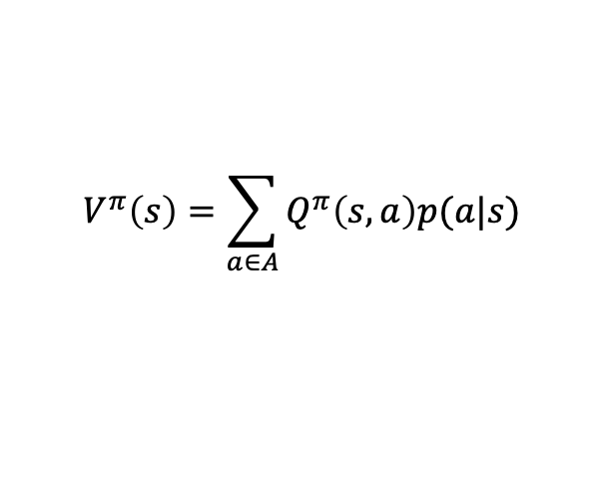
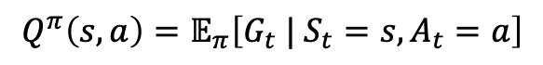
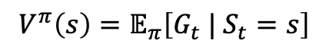
Value Function
The “true” value of a state, denoted $V(s)$, is the expected sum of discounted rewards if the agent executes an optimal policy starting in state $s$
Similarly, we define the action-value of a state-action pair as
The relationship between Q and V
$$V^{π}\left(s\right)=𝔼_{π}\left[G_{t} | S_{t}=s\right]$$
$$Q^{π}\left(s,a\right)=𝔼_{π}\left[G_{t} | S_{t}=s, A_{t}=a\right]$$
$$V^{π}\left(s\right)=\sum_{a∈A}{Q^{π}\left(s,a\right)p(a|s)}$$
Notes:
The V here is not a reward. It is a value. A value very similar to the policy function, who is a function of s. The difference is: the value’s return is a scalar, the policy’s output is an action.
V(s) = G1+G2+G3+G4
Ask a question: how to make the connection between the current and the future?

Slide 21
Recursive Mechanism

Slide 22
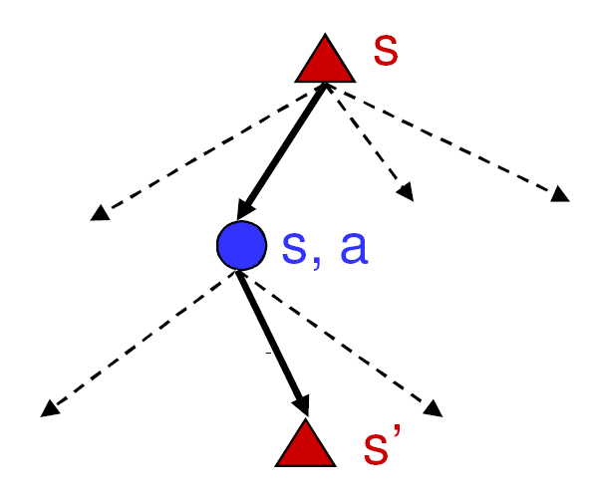
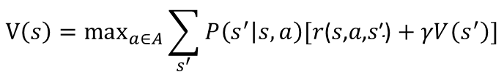
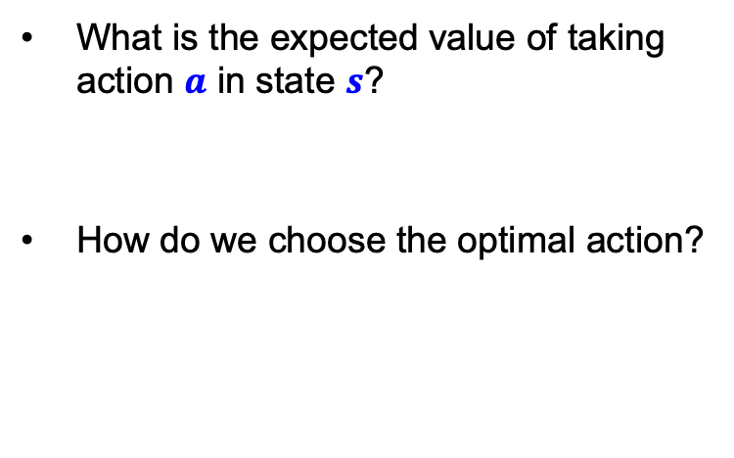
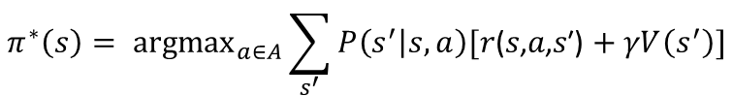
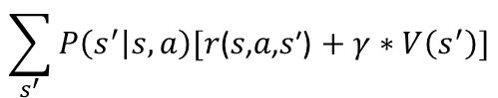
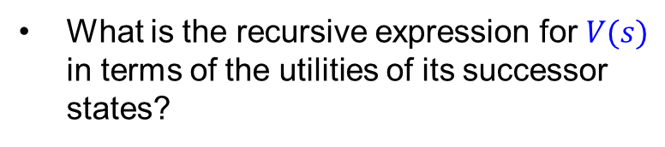
Finding the Value Function of States
What is the expected value of taking action $a$ in state $s$?
How do we choose the optimal action?
Max node
$$\sum_{s^{′}}{P\left(s^{′} | s, a\right)[\text{r}\text{(}\text{s}\text{,}\text{a}\text{,}\text{s}\text{′)}+γ∗V\left(s^{′}\right)]}$$
Chance node
$$π^{∗}\left(s\right)= {argmax}_{a∈A}\sum_{s^{′}}{P\left(s^{′} | s, a\right)[\text{r}\text{(}\text{s}\text{,}\text{a}\text{,}\text{s}\text{′)}+γV\left(s^{′}\right)]}$$
P(s’ | s, a)
𝑟(𝑠,𝑎,𝑠′)
What is the recursive expression for $V(s)$ in terms of the utilities of its successor states?
V(s’)
$$V\left(s\right)=\max_{a∈A}\sum_{s^{′}}{P\left(s^{′} | s, a\right)[\text{r}\text{(}\text{s}\text{,}\text{a}\text{,}\text{s}\text{′)}+γV\left(s^{′}\right)]}$$
Notes:
We need to break down the first equation: Gt = R+ gamma V(t+1)
So, we have a further breakdown here: a connection between one-step ahead: from S to S’.
Note that the pi start here is not the policy function.
From the second equation, we only know the result of the pi function, but does not know the probability of choosing a.
You can consider the star is a blackbox form of pi. We don’t have the analytical form.

Slide 23
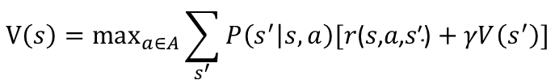
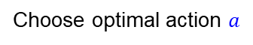
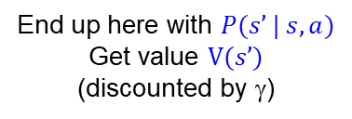
The Bellman Equation
Recursive relationship between the accumulated rewards of successive states:
For N states, we get N equations in N unknowns
Solving them solves the MDP
We could try to solve them through expectimax search, but that would run into trouble with infinite sequences
Instead, we solve them algebraically
Two methods: value iteration and policy iteration
$$V\left(s\right)=\max_{a∈A}\sum_{s^{′}}{P\left(s^{′} | s, a\right)[\text{r}\text{(}\text{s}\text{,}\text{a}\text{,}\text{s}\text{′)}+γV\left(s^{′}\right)]}$$
Choose optimal action $a$
Receive reward 𝑟(𝑠,𝑎,𝑠′)
End up here with $P(s’ | s, a)$
Get value $V(s’)$
(discounted by γ)
Notes:
V(s) is the unknown. If you have this, you also have pi(s).

Slide 24
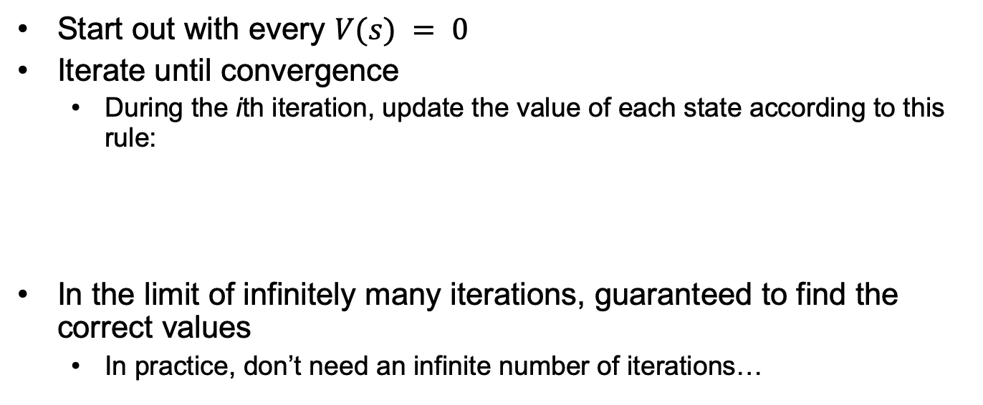
Method 1: Value Iteration
Start out with every $V(s) = 0$
Iterate until convergence
During the ith iteration, update the value of each state according to this rule:
In the limit of infinitely many iterations, guaranteed to find the correct values
In practice, don’t need an infinite number of iterations…
$$V_{i+1}\left(s\right)=\max_{a}{\sum_{s^{′}∈S}{P(s^{′}|s, a)}\left[R\left(s, a, s^{′ }\right)+γV_{i}(s^{′})\right]}$$
Notes:
Show that x1+x2 = 4 and x1-x2 = 5 not work in general.

Slide 25
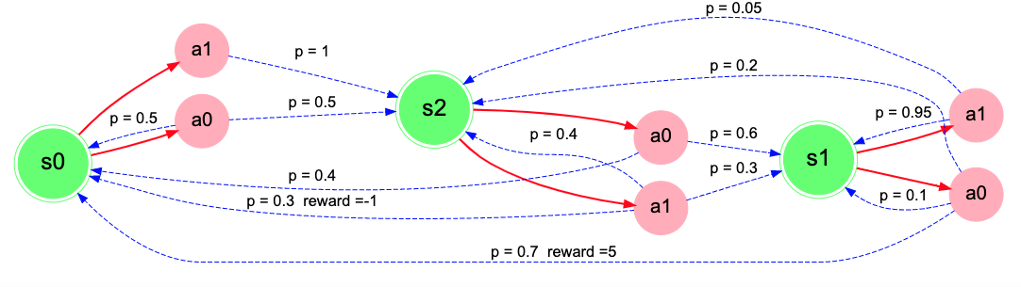
Value Iteration: Example
A simple example to show how VI works
State, action, reward (non-zero) and transition probability are shown in the figure
We use this example as an MDP and solve it using VI and PI
These structure can be easily implemented by dict of Python or HashMap of Java
Notes:
Ask: how many states? Actions? R(s,a,s’)?

Slide 26
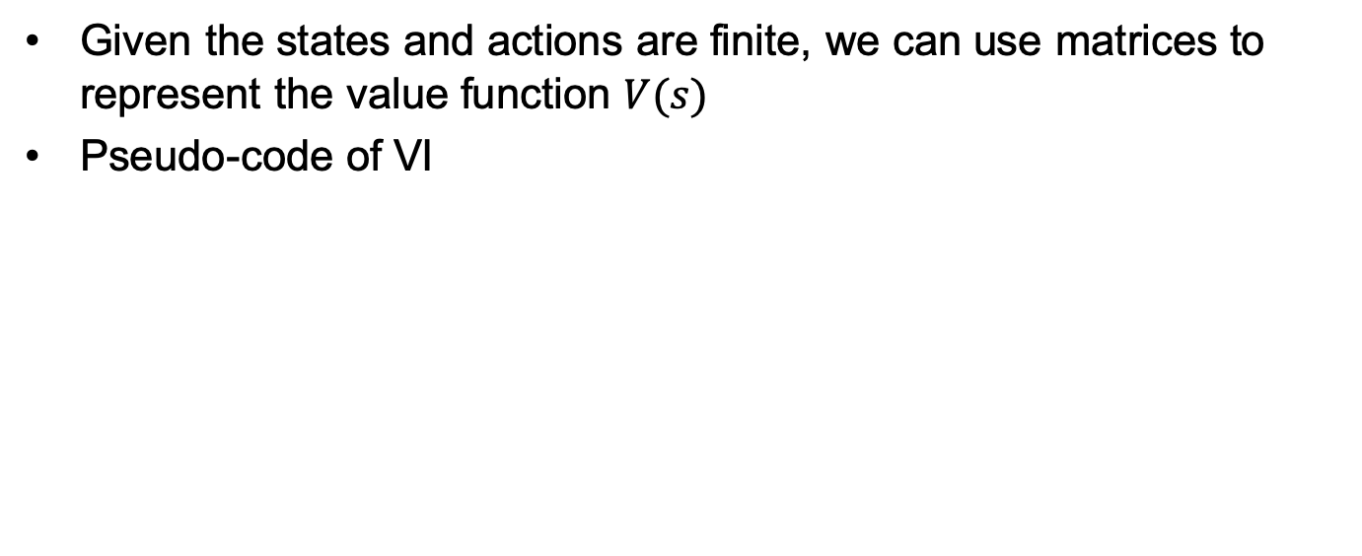
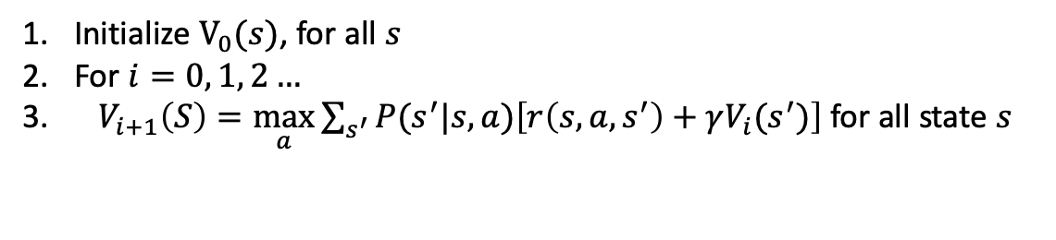
Value Iteration: Example (cont’d)
Given the states and actions are finite, we can use matrices to represent the value function $V(s)$
Pseudo-code of VI
Initialize $V_{0}(s)$, for all $s$
For $i=0, 1, 2…$
$V_{i+1}\left(S\right)=\max_{a}{\sum_{s^{′}}{P(s^{′}|s, a)\left[r\left(s, a,s^{′}\right)+γV_{i}(s^{′})\right]}}$ for all state $s$

Slide 27
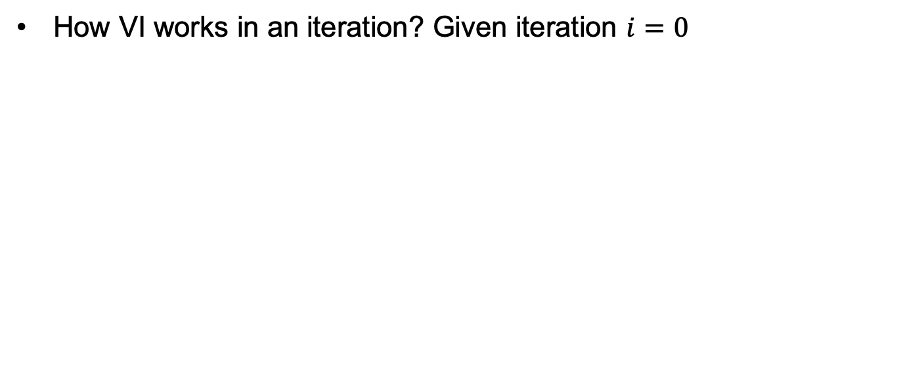
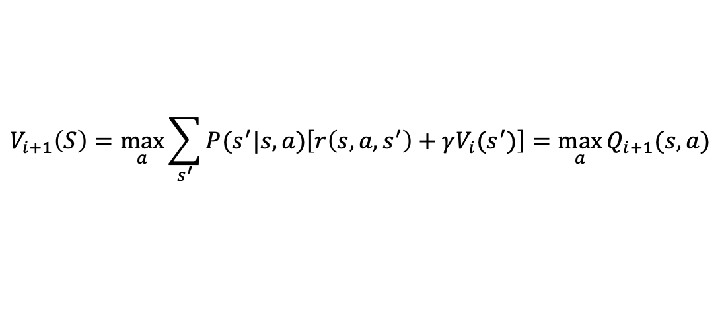
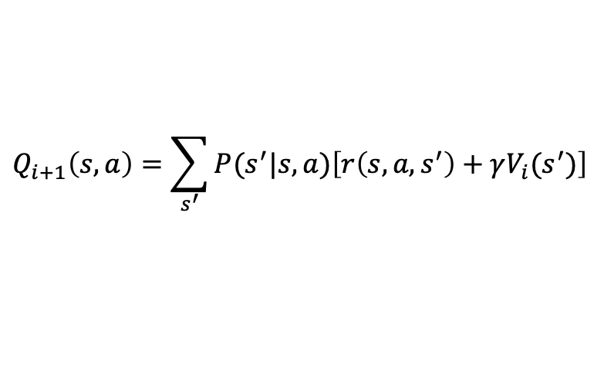
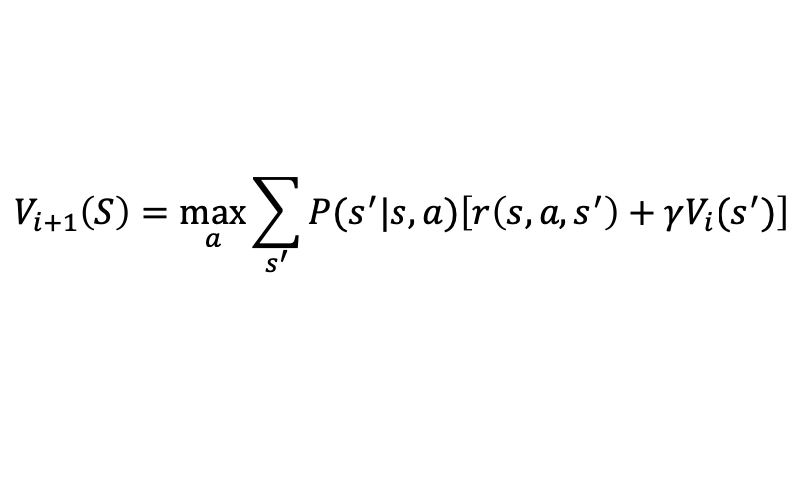
Value Iteration: Example
Value Iteration: Example (cont’d)
How VI works in an iteration? Given iteration $i=0$
For all state find
$$V_{i+1}\left(S\right)=\max_{a}{\sum_{s^{′}}{P(s^{′}|s, a)\left[r\left(s, a,s^{′}\right)+γV_{i}(s^{′})\right]}}$$
We can instead calculate Q(s, a) values for each $s$ and a and get the best V(s)
$$Q_{i+1}\left(s,a\right)=\sum_{s^{′}}{P(s^{′}|s,a)\left[r\left(s, a,s^{′}\right)+γV_{i}(s^{′})\right]}$$
Finally
$$V_{i+1}\left(S\right)=\max_{a}{\sum_{s^{′}}{P(s^{′}|s, a)\left[r\left(s, a,s^{′}\right)+γV_{i}(s^{′})\right]}}=\max_{a}{Q_{i+1}(s,a)}$$
Notes:
The reason why we can use maxQ(s,a) for V but not rigorous exp, is because we consider the pi(s,a) as a probability delta function. (impulse, only have probability at argmax a)

Slide 28
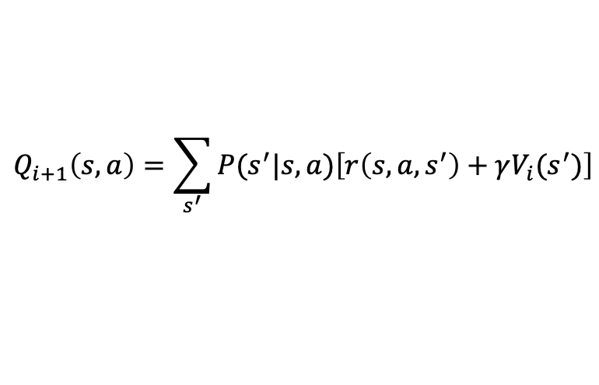
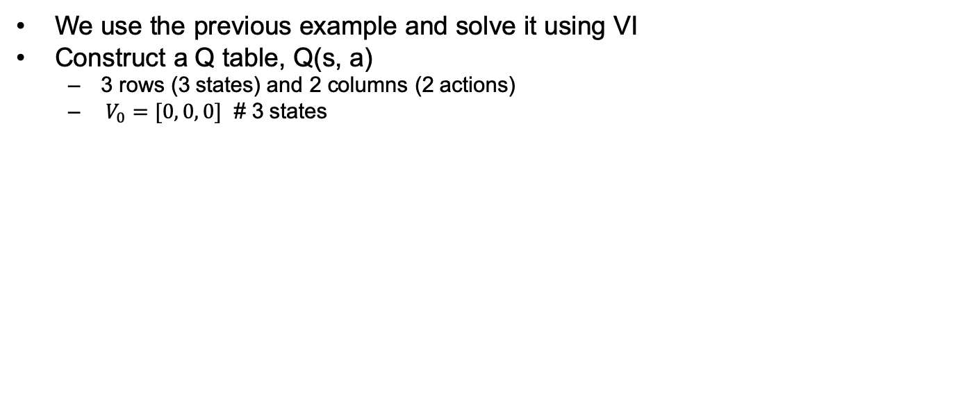
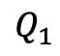
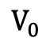
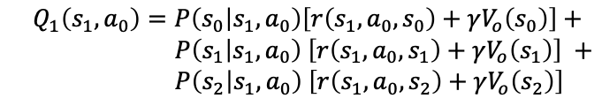
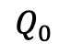
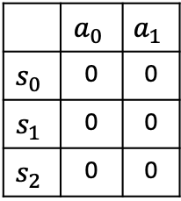
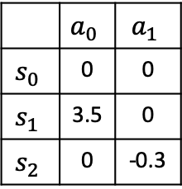
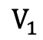
Value Iteration: Example
Value Iteration: Example (cont’d)
We use the previous example and solve it using VI
Construct a Q table, Q(s, a)
3 rows (3 states) and 2 columns (2 actions)
$V_{0}=[0, 0, 0]$ # 3 states
$$Q_{i+1}\left(s,a\right)=\sum_{s^{′}}{P(s^{′}|s,a)\left[r\left(s, a,s^{′}\right)+γV_{i}(s^{′})\right]}$$
$$Q_{0}$$
$$V_{0}$$
$$Q_{1}$$
$$V_{1}$$
 | $$a_{0}$$ | $$a_{1}$$
$$s_{0}$$ | 0 | 0
$$s_{1}$$ | 0 | 0
$$s_{2}$$ | 0 | 0
0
0
0
 | $$a_{0}$$ | $$a_{1}$$
$$s_{0}$$ | 0 | 0
$$s_{1}$$ | 3.5 | 0
$$s_{2}$$ | 0 | -0.3
0
3.5
0
$$Q_{1}\left(s_{1},a_{0}\right)=P\left(s_{0} | s_{1},a_{0}\right)\left[r\left(s_{1},a_{0},s_{0}\right)+γV_{o}\left(s_{0}\right)\right]+$$ $P\left(s_{1} | s_{1},a_{0}\right)$ $\left[r\left(s_{1},a_{0},s_{1}\right)+γV_{o}\left(s_{1}\right)\right] +$ $P\left(s_{2} | s_{1},a_{0}\right)$ $\left[r\left(s_{1},a_{0},s_{2}\right)+γV_{o}\left(s_{2}\right)\right]$
$$Q_{1}\left(s_{1},a_{0}\right)=0.7∗\left[5+0\right]+0.1∗\left[0+0\right]+0.2∗\left[0+0\right]=3.5$$
The initial Q and V table
Repeat this process until it converges

Slide 29
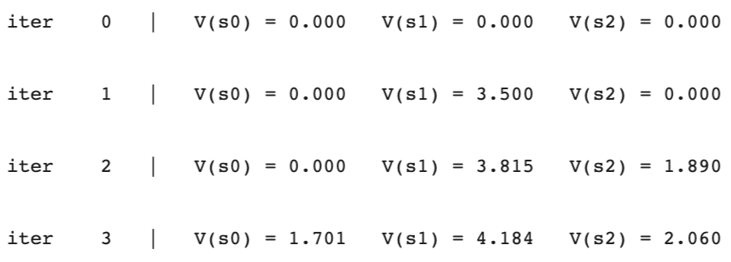
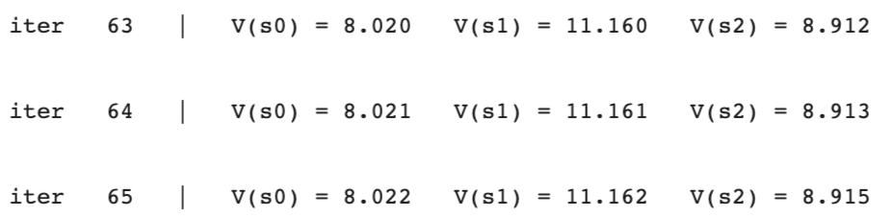
Value Iteration: Example
Value Iteration: Example (cont’d)
Iterating the process (code available on later slides)
Very good, the values converge now
. . . . . .

Slide 30
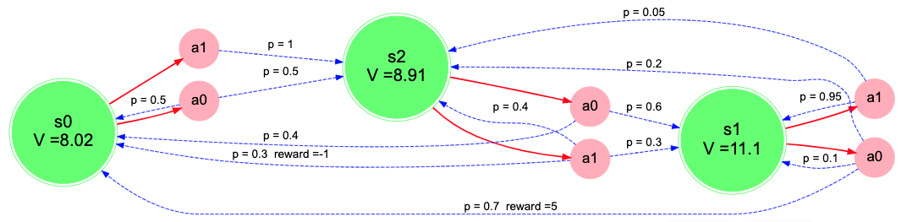
Value Iteration: Example
Value Iteration: Example (cont’d)
Put the optimal values on the graph

Slide 31
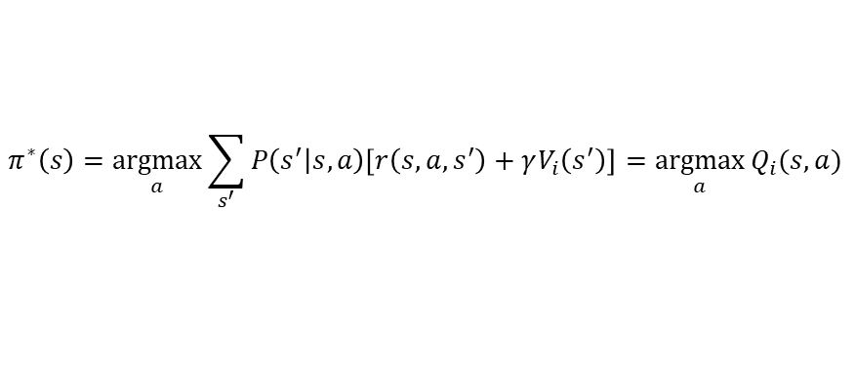



Value Iteration: Example (cont’d)
Use $V^{∗}$ to find optimal policy
aka optimal actions in each state
$$π^{∗}\left(s\right)=\underset{a}{argmax}{\sum_{s^{′}}{P\left(s^{′} | s, a\right)\left[r\left(s, a,s^{′}\right)+γV_{i}\left(s^{′}\right)\right]=\underset{a}{argmax}{Q_{i}(s,a)}}}$$
 | $$a^{∗}$$
$$s_{0}$$ | $$a_{1}$$
$$s_{1}$$ | $$a_{0}$$
$$s_{2}$$ | $$a_{0}$$
$$π^{∗}$$
Done! We get the optimal policy of the example
Search Markov Decision Process (MDP) Toolbox for Python

Slide 32


Grid World
$$Q_{i+1}\left(s,a\right)=\sum_{s^{′}}{P(s^{′}|s,a)\left[r\left(s, a,s^{′}\right)+γV_{i}(s^{′})\right]}$$
$$Q_{1}\left(s_{0},a_{0}\right)=P\left(s_{0} | s_{0},a_{0}\right)\left[r\left(s_{0},a_{0},s_{0}\right)+γV_{o}\left(s_{0}\right)\right]+$$ $P\left(s_{1} | s_{0},a_{0}\right)$ $\left[r\left(s_{0},a_{0},s_{1}\right)+γV_{o}\left(s_{1}\right)\right] +$ $P\left(s_{2} | s_{0},a_{0}\right)$ $\left[r\left(s_{0},a_{0},s_{2}\right)+γV_{o}\left(s_{2}\right)\right]$
$$Q_{1}\left((1,1),Up\right)=0.1∗\left[−0.4+0\right]+0.8∗\left[−0.4+0\right]+0.1∗\left[−0.4+0\right]=−0.4$$
Notes:
A0 = up, a1 = right, a2 = left, a3 = down
S0 = (1,1), s1 = (2,1), s2 = (1,2)
R = -0.4

Slide 33



Method 2: Policy Iteration
Start with some initial policy π₀ and alternate between the following steps:
Policy evaluation: calculate $V^{π_{i}}(s)$ for every state s, like VI
Policy improvement: calculate a new policy $π_{i+1}$based on the updated utilities
$π_{i+1}\left(s\right)= {argmax}_{a∈A}\sum_{s^{′}}{P\left(s^{′} | s, a\right){[r\left(s, a,s^{′}\right)+γV}^{π_{i}}(s′)}$]
Notes:
Just now, value iteration is just a delegate of PI. How about directly learn the PI.
At ideal state, V is from pi, however, there is disparate, as everytime, we choose a greedy one. Fortunately, we can show convergence of the greedy.

Slide 34

Policy Iteration: Main Steps
Unlike VI, policy iteration has to maintain a policy - chosen actions from all states - and estimate $V^{π_{i}}$ based on this policy.
Iterate this process until convergence (like VI)
Steps of PI
Initialization
Policy Evaluation (calculating the $V$)
Policy Improvement (calculate the policy $π$)

Slide 35


Policy Iteration: Detailed Steps
Initialization
Initialize $V(s)$ and $π(s)$ for all state $s$
Policy Evaluation (calculate the $V$)
Repeat
$Δ←0$
For each state $s:$
$v←V\left(s\right)$
$V\left(s\right)←\sum_{s^{′}}{p\left(s^{′} | s,π(s)\right)\left[R\left(s, π(s), s^{′}\right)+γV\left(s^{′}\right)\right]}$
$Δ←max⁡(Δ,\left|v−V\left(s\right)\right|)$
until $Δ<ω$ (a small positive number)
Policy Improvement (calculate the new policy $π$)
$policystable←True$
For each state $s:$
$b←π(s)$
$π\left(s\right)←{argmax}_{π(s)}\sum_{s^{′}}{p\left(s^{′} | s,π(s)\right)\left[R\left(s, π(s), s^{′}\right)+γV\left(s^{′}\right)\right]}$
If $b≠π(s)$, then $policystable←False$
If $policystable←True,$ then stop; else go to step 2;
Use current Policy to stabilize Value
Use current Value to stabilize Policy
Notes:
The first step is an approximation of the expectation.

Slide 36





Policy Iteration: Policy Evaluation
Use the example used in VI
Start iteration $i=0$, initialize random $π$, $γ=0.99$, and $V\left(s\right)=0$ for all state $s$
$$V^{π_{i}}\left(s\right)=\sum_{s^{′}}{P\left(s, π_{i}\left(s\right), s^{′}\right)\left[R\left(s, π_{i}\left(s\right), s^{′}\right)+γV^{π_{i}}(s^{′})\right]}$$
$V\left(s_{0}\right)←P\left(s_{0}, π\left(s_{0}\right), s_{0}\right)\left[R\left(s_{0}, π\left(s_{0}\right), s_{0}\right)+γV(s_{0})\right]$ + $P\left(s_{0}, π\left(s_{0}\right), s_{1}\right)\left[R\left(s_{0}, π\left(s_{0}\right), s_{1}\right)+γV(s_{1})\right]$ + $P\left(s_{0}, π\left(s_{0}\right), s_{2}\right)\left[R\left(s_{0}, π\left(s_{0}\right), s_{2}\right)+γV(s_{2})\right]$
$V\left(s_{1}\right)←P\left(s_{1}, π\left(s_{1}\right), s_{0}\right)\left[R\left(s_{1}, π\left(s_{1}\right), s_{0}\right)+γV(s_{0})\right]$ + $P\left(s_{1}, π\left(s_{1}\right), s_{1}\right)\left[R\left(s_{1}, π\left(s_{1}\right), s_{1}\right)+γV(s_{1})\right]$ + $P\left(s_{1}, π\left(s_{1}\right), s_{2}\right)\left[R\left(s_{1}, π\left(s_{1}\right), s_{2}\right)+γV(s_{2})\right]$
$V\left(s_{2}\right)←P\left(s_{2}, π\left(s_{2}\right), s_{0}\right)\left[R\left(s_{2}, π\left(s_{2}\right), s_{0}\right)+γV(s_{0})\right]$ + $P\left(s_{2}, π\left(s_{2}\right), s_{1}\right)\left[R\left(s_{2}, π\left(s_{2}\right), s_{1}\right)+γV(s_{1})\right]$ + $P\left(s_{2}, π\left(s_{2}\right), s_{2}\right)\left[R\left(s_{2}, π\left(s_{2}\right), s_{2}\right)+γV(s_{2})\right]$

Slide 37


Policy Iteration: Policy Evaluation (cont’d)
Use the example used in VI
Start iteration $i=0$, $γ=0.99$, initialize random$π=\left[a_{1}, a_{0},a_{1}\right]$ and $V\left(s\right)=0$ for states $s_{0}$, $s_{1}$ and $s_{2}$
Values are calculated asynchronously
The converged values are used for policy improvement
$V\left(s_{0}\right)←0.0\left[0.0+γV(s_{0})\right]$ + $0.0\left[0.0+γV(s_{1})\right]$ +$1.0\left[0.0+γV(s_{2})\right]$
$V\left(s_{1}\right)←0.7\left[5.0+γV(s_{0})\right]$ + $0.1\left[0.0+γV(s_{1})\right]$ + $0.2\left[0.0+γV(s_{2})\right]$
$V\left(s_{2}\right)←0.3\left[−1+γV(s_{0})\right]$ + $0.3\left[0.0+γV(s_{1})\right]$ + $0.4\left[0.0+γV(s_{2})\right]$
$$V\left(s_{0}\right)=0$$
$$V\left(s_{1}\right)=0.7∗5.0=3.5$$
$$V\left(s_{2}\right)=0.3∗\left(−1\right)+0.3∗\left(0.99∗3.5\right)=0.7395$$
… loop this process as instructed in step 2 …

Slide 38



Policy Iteration: Example (cont’d)
The optimal Q values are
Nearly the same as that of VI (as shown in the figure below)
We can easily calculate the optimal policy. Can you try it?
 | $$V^{∗}$$
$$s_{0}$$ | 8.03
$$s_{1}$$ | 11.2
$$s_{2}$$ | 8.9
 | $$a^{∗}$$
$$s_{0}$$ | $$a_{1}$$
$$s_{1}$$ | $$a_{0}$$
$$s_{2}$$ | $$a_{0}$$
$$π^{∗}$$
Notes:
Discuss about the policy vs value. Some times, it is hard/not necessary to model the policy explicitly. If your objective is to maximize the value at every step.
Think of the good and bad of Policy Iteration and Value Iteration.

